Slide 1
Java Script
Module 2

Slide 2
Content
Statements
Syntax
Function
Objects

Slide 3
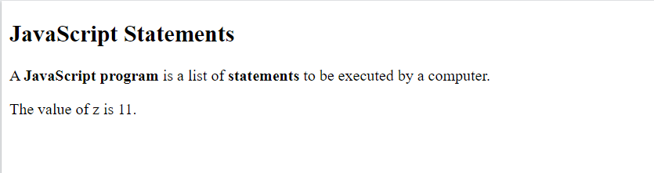
JavaScript Statements
<!DOCTYPE html>
<html>
<body>
<h2>JavaScript Statements</h2>
<p>A <b>JavaScript program</b> is a list of <b>statements</b> to be executed by a computer.</p>
<p id="demo"></p>
<script>
let x, y, z; // Statement 1
x = 5; // Statement 2
y = 6; // Statement 3
z = x + y; // Statement 4
document.getElementById("demo").innerHTML = "The value of z is " + z + ".";
</script>
</body>
</html>
A computer program is a list of "instructions" to be "executed" by a computer.
In a programming language, these programming instructions are called statements.
A JavaScript program is a list of programming statements.
In HTML, JavaScript programs are executed by the web browser.
JavaScript statements are composed of:
Values
Operators
Expressions
Keywords
Comments.

Slide 4
JavaScript Statements
Most JavaScript programs contain many JavaScript statements.
The statements are executed, one by one, in the same order as they are written.
JavaScript programs (and JavaScript statements) are often called JavaScript code
Semicolons:
Semicolons separate JavaScript statements.
Add a semicolon at the end of each executable statement
When separated by semicolons, multiple statements on one line are allowed
Ending statements with semicolon is not required, but highly recommended
<!DOCTYPE html>
<html>
<body>
<h2>JavaScript Statements</h2>
<p>A <b>JavaScript program</b> is a list of <b>statements</b> to be executed by a computer.</p>
<p id="demo"></p>
<script>
let x, y, z; // Statement 1
x = 5; // Statement 2
y = 6; // Statement 3
z = x + y; // Statement 4
document.getElementById("demo").innerHTML = "The value of z is " + z + ".";
</script>
</body>
</html>

Slide 5
JavaScript Statements
JavaScript White Space
JavaScript ignores multiple spaces.
We can add white space to your script to make it more readable
A good practice is to put spaces around operators ( = + - * / )
JavaScript Line Length and Line Breaks
For best readability, programmers often like to avoid code lines longer than 80 characters.
If a JavaScript statement does not fit on one line, the best place to break it is after an operator:
<!DOCTYPE html>
<html>
<body>
<h2>JavaScript Statements</h2>
<p>A <b>JavaScript program</b> is a list of <b>statements</b> to be executed by a computer.</p>
<p id="demo"></p>
<script>
let x, y, z; // Statement 1
x = 5; // Statement 2
y = 6; // Statement 3
z = x + y; // Statement 4
document.getElementById("demo").innerHTML = "The value of z is " + z + ".";
</script>
</body>
</html>

Slide 6
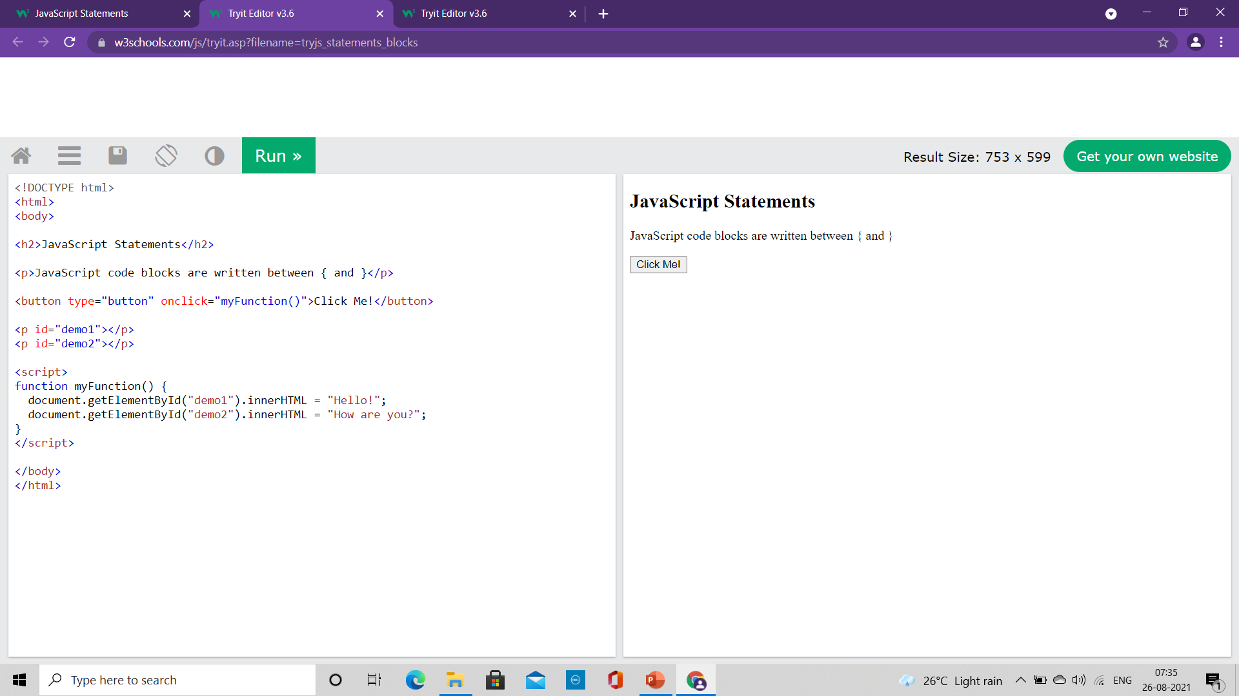
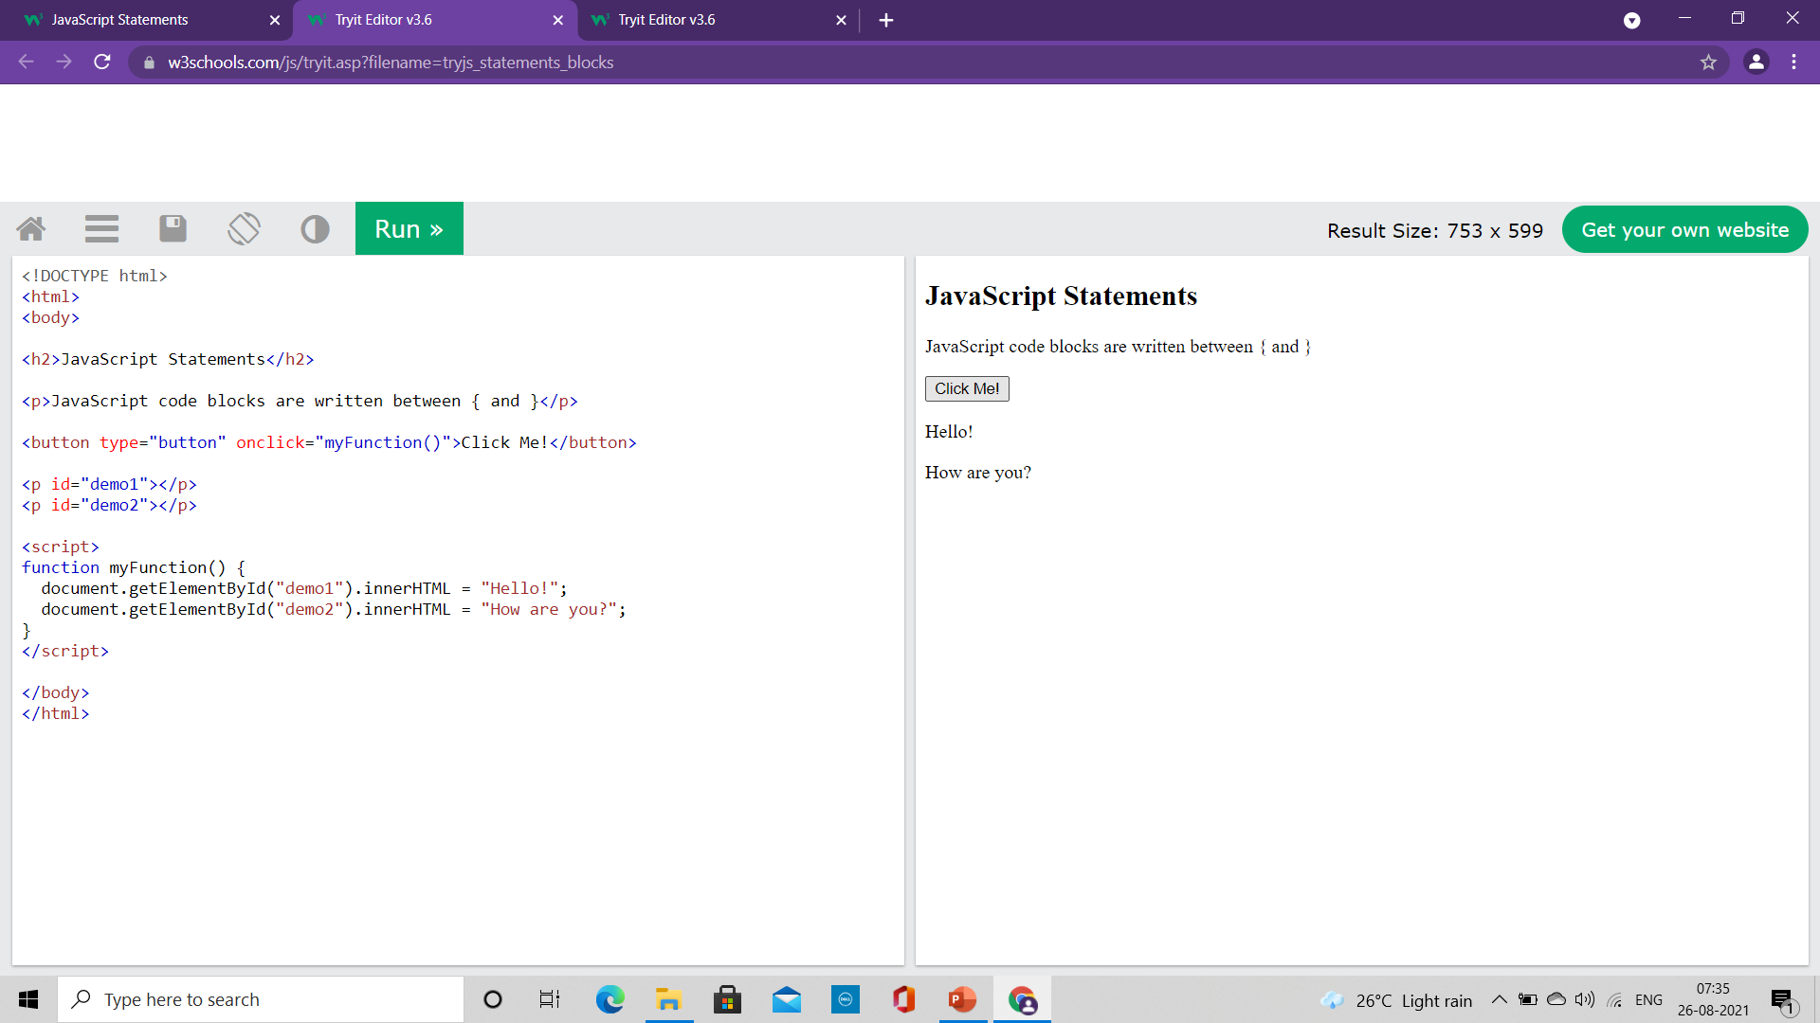
JavaScript Statements
JavaScript Code Blocks
JavaScript statements can be grouped together in code blocks, inside curly brackets {...}.
The purpose of code blocks is to define statements to be executed together.
One place you will find statements grouped together in blocks, is in JavaScript functions
<!DOCTYPE html>
<html>
<body>
<h2>JavaScript Statements</h2>
<p>JavaScript code blocks are written between { and }</p>
<button type="button" onclick="myFunction()">Click Me!</button>
<p id="demo1"></p>
<p id="demo2"></p>
<script>
function myFunction() {
document.getElementById("demo1").innerHTML = "Hello!";
document.getElementById("demo2").innerHTML = "How are you?";
}
</script>
</body>
</html>

Slide 7
JavaScript Keywords
JavaScript statements often start with a keyword to identify the JavaScript action to be performed.
Some of the keywords:
Keyword Description
var Declares a variable
let Declares a block variable
const Declares a block constant
if Marks a block of statements to be executed on a condition
switch Marks a block of statements to be executed in different cases
for Marks a block of statements to be executed in a loop
function Declares a function
return Exits a function
try Implements error handling to a block of statements

Slide 8
JavaScript Syntax
JavaScript syntax is the set of rules, how JavaScript programs are constructed
JavaScript Values
The JavaScript syntax defines two types of values:
Fixed values – Literals
Variable values – Variables
JavaScript Literals
The two most important syntax rules for fixed values are:
Numbers are written with or without decimals
Strings are text, written within double or single quotes
JavaScript Variables
In a programming language, variables are used to store data values.
JavaScript uses the keywords var, let and const to declare variables.
An equal sign is used to assign values to variables.

Slide 9
JavaScript Syntax
JavaScript syntax is the set of rules, how JavaScript programs are constructed
JavaScript Operators
Arithmetic operators: + , - , * , / , ** , % , ++ , --
Assignment operator: = , += , -= , *= , /= , %= , **=
String operator: + , +=
Comparison Operator: == (Equal to) , === (Equal Value and Equal Type), != , < , > , <= , >= , ?
Logical Operator: && , || , !
Type Operators: typeof, instanceof
Bitwise Operators: & , | , ~ , ^ , << , >>

Slide 10
JavaScript Syntax
JavaScript syntax is the set of rules, how JavaScript programs are constructed
JavaScript Operators
Arithmetic operators: Addition ( + ), Subtraction( - ), Multiplication( * ), Division ( / )
Assignment operator: ( = )
JavaScript Expressions
An expression is a combination of values, variables, and operators, which computes to a value.
The computation is called an evaluation.
For example, 5 * 10 evaluates to 50
Expressions can also contain variable values
The values can be of various types, such as numbers and strings.
For example, "John" + " " + "Doe", evaluates to "John Doe"

Slide 11
JavaScript Syntax
JavaScript Comments
Not all JavaScript statements are "executed".
Code after double slashes // or between /* and */ is treated as a comment.
Comments are ignored, and will not be executed
JavaScript Identifiers
Identifiers are names.
In JavaScript, identifiers are used to name variables (and keywords, and functions, and labels).
The rules for legal names are much the same in most programming languages.
In JavaScript, the first character must be a letter, or an underscore (_), or a dollar sign ($).
Numbers are not allowed as the first character.
Subsequent characters may be letters, digits, underscores, or dollar signs.
All JavaScript identifiers are case sensitive
JavaScript programmers tend to use camel case that starts with a lowercase letter:
Example: firstName, lastName, masterCard, interCity

Slide 12
JavaScript Functions
It is a block of code designed to perform a particular task
It is executed when "something" invokes it (calls it)
Syntax:
It is defined with the function keyword, followed by a name, followed by parentheses ().
Function names can contain letters, digits, underscores, and dollar signs (same rules as variables).
The parentheses may include parameter names separated by commas:
(parameter1, parameter2, ...)
The code to be executed, by the function, is placed inside curly brackets: { }
Function parameters are listed inside the parentheses () in the function definition.
Function arguments are the values received by the function when it is invoked.
Inside the function, the arguments (the parameters) behave as local variables.
A Function is much the same as a Procedure or a Subroutine, in other programming languages.
function name(parameter1, parameter2, parameter3) { // code to be executed }

Slide 13
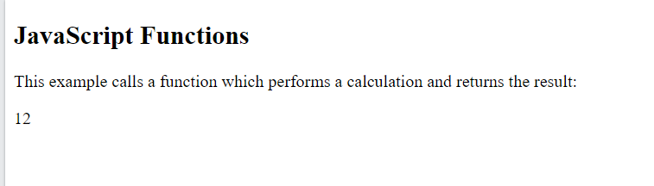
JavaScript Functions
Function Invocation
The code inside the function will execute when "something" invokes (calls) the function:
When an event occurs (when a user clicks a button)
When it is invoked (called) from JavaScript code
Automatically (self invoked)
Function Return
When JavaScript reaches a return statement, the function will stop executing.
If the function was invoked from a statement, JavaScript will "return" to execute the code after the invoking statement.
Functions often compute a return value. The return value is "returned" back to the "caller
<!DOCTYPE html>
<html>
<body>
<h2>JavaScript Functions</h2>
<p>This example calls a function which performs a calculation and returns the result:</p>
<p id="demo"></p>
<script>
var x = myFunction(4, 3);
document.getElementById("demo").innerHTML = x;
function myFunction(a, b) {
return a * b;
}
</script>
</body>
</html>

Slide 14
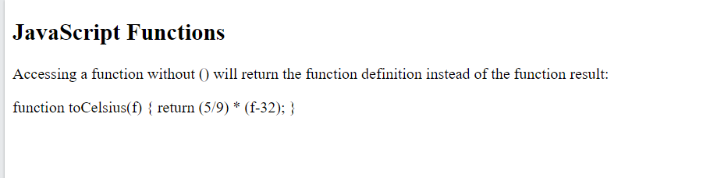
JavaScript Functions
Function Invocation
Accessing a function without () will return the function object instead of the function result.
<!DOCTYPE html>
<html>
<body>
<h2>JavaScript Functions</h2>
<p>Accessing a function without () will return the function definition instead of the function result:</p>
<p id="demo"></p>
<script>
function toCelsius(f) {
return (5/9) * (f-32);
}
document.getElementById("demo").innerHTML = toCelsius;
</script>
</body>
</html>

Slide 15
JavaScript Objects
Real Life Objects, Properties, and Methods
In real life, a car is an object.
A car has properties like weight and color, and methods like start and stop
All cars have the same properties, but the property values differ from car to car.
All cars have the same methods, but the methods are performed at different times.
JavaScript Objects
Objects are variables but it contain many values.
The values are written as name:value pairs (name and value separated by a colon).
It is a common practice to declare objects with the const keyword.
We can define (and create) a JavaScript object with an object literal
Spaces and line breaks are not important. An object definition can span multiple lines

Slide 16
JavaScript Objects
Function Invocation
Accessing a function without () will return the function object instead of the function result.
<!DOCTYPE html>
<html>
<body>
<h2>JavaScript Objects</h2>
<p id="demo"></p>
<script>
// Create an object:
const car = {type:"Fiat", model:"500", color:"white"};
// Display some data from the object:
document.getElementById("demo").innerHTML = "The car type is " + car.type;
</script>
</body>
</html>

Slide 18
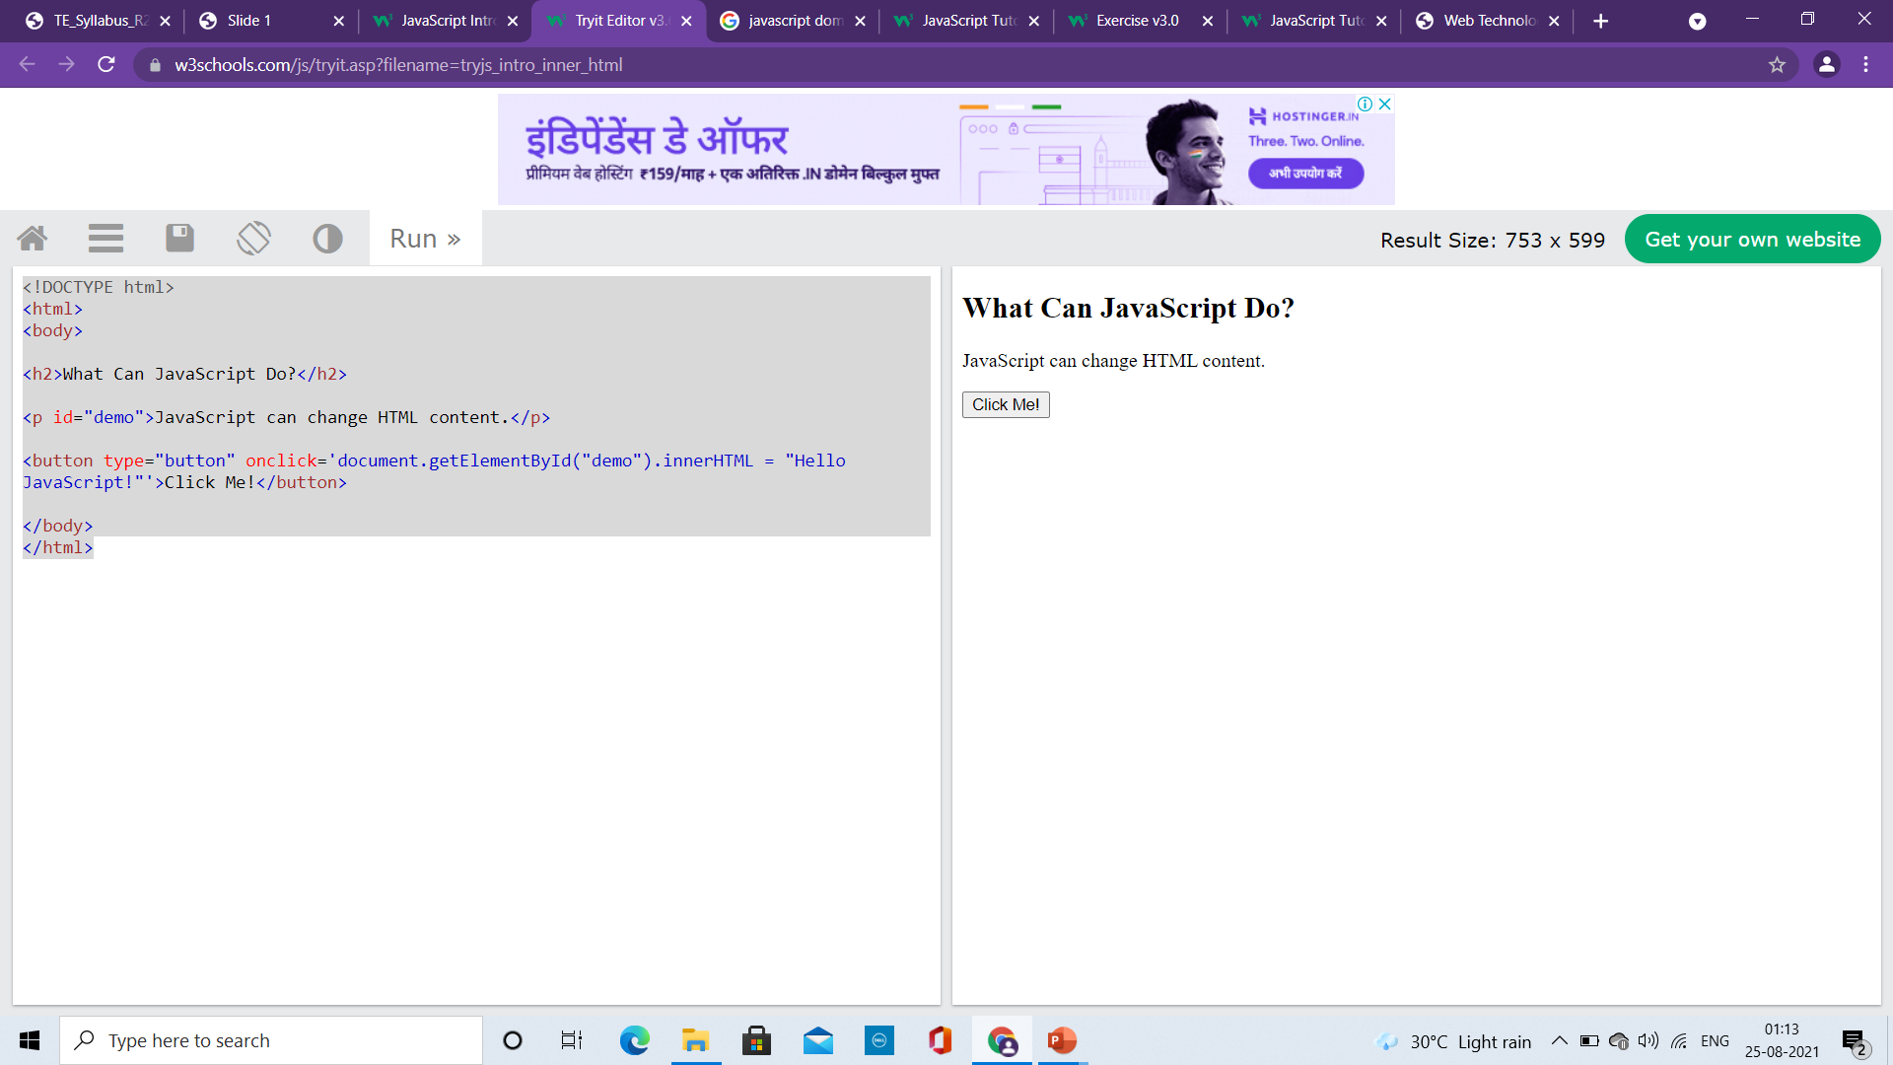
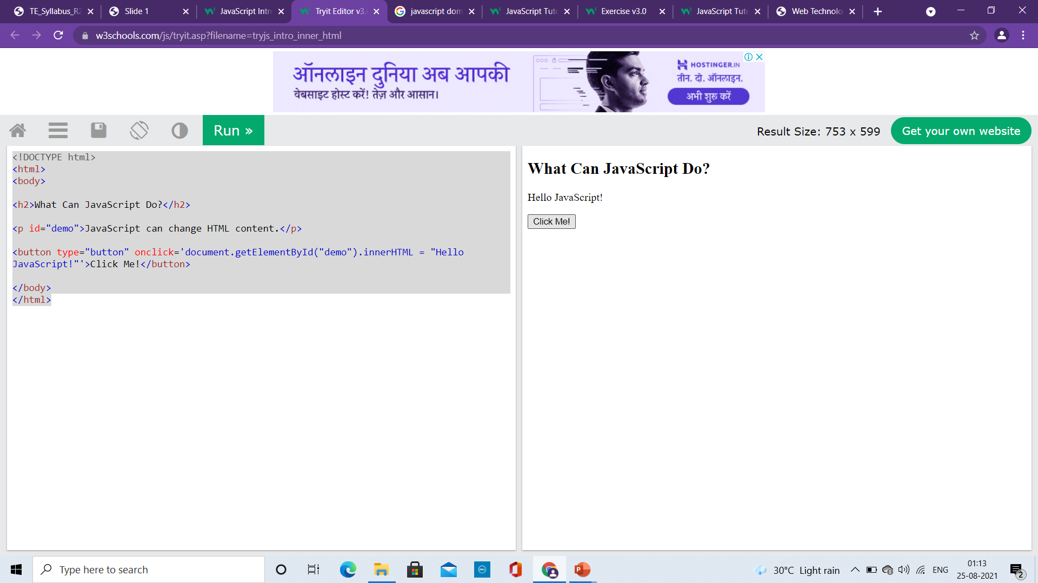
What JavaScript can do?
Change HTML Style (CSS)
<!DOCTYPE html>
<html>
<body>
<h2>What Can JavaScript Do?</h2>
<p id="demo">JavaScript can change HTML content.</p>
<button type="button" onclick="document.getElementById('demo').innerHTML = 'Hello JavaScript!'">Click Me!</button>
</body>
</html>

Slide 19
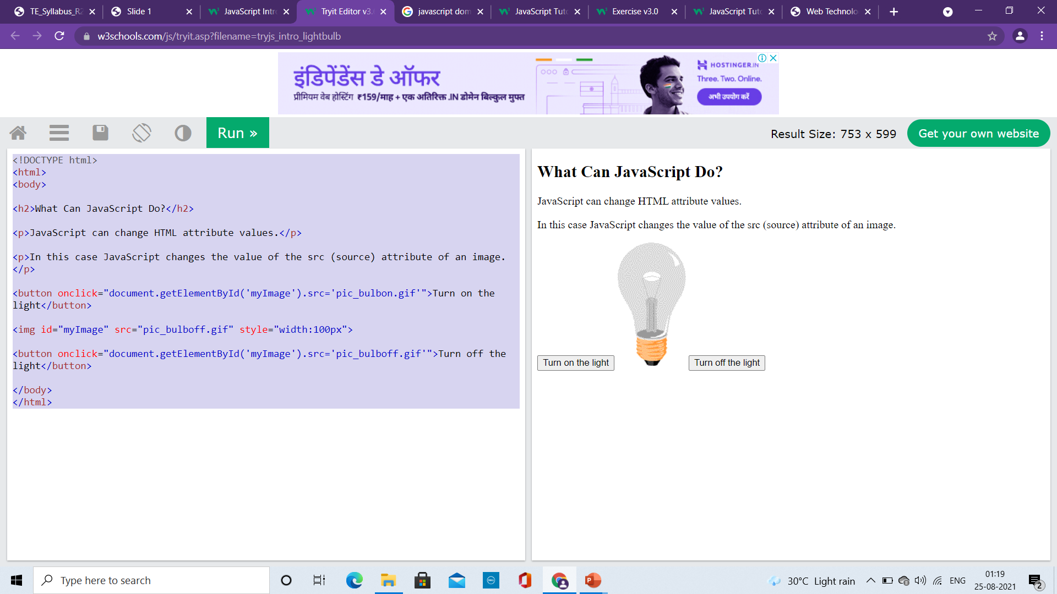
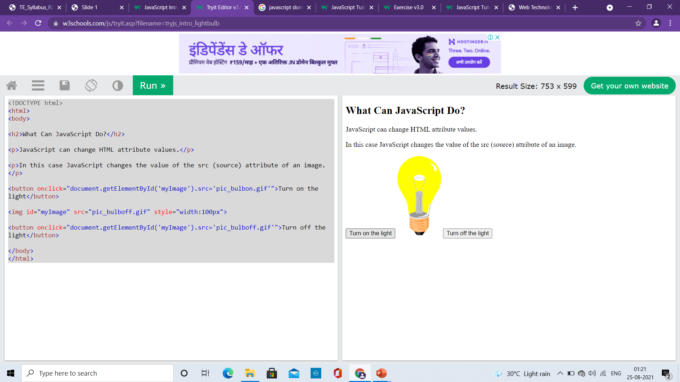
What JavaScript can do?
Change HTML Attribute Values
<!DOCTYPE html>
<html>
<body>
<h2>What Can JavaScript Do?</h2>
<p>JavaScript can change HTML attribute values.</p>
<p>In this case JavaScript changes the value of the src (source) attribute of an image.</p>
<button onclick="document.getElementById('myImage').src='pic_bulbon.gif'">Turn on the light</button>
<img id="myImage" src="pic_bulboff.gif" style="width:100px">
<button onclick="document.getElementById('myImage').src='pic_bulboff.gif'">Turn off the light</button>
</body>
</html>

Slide 20
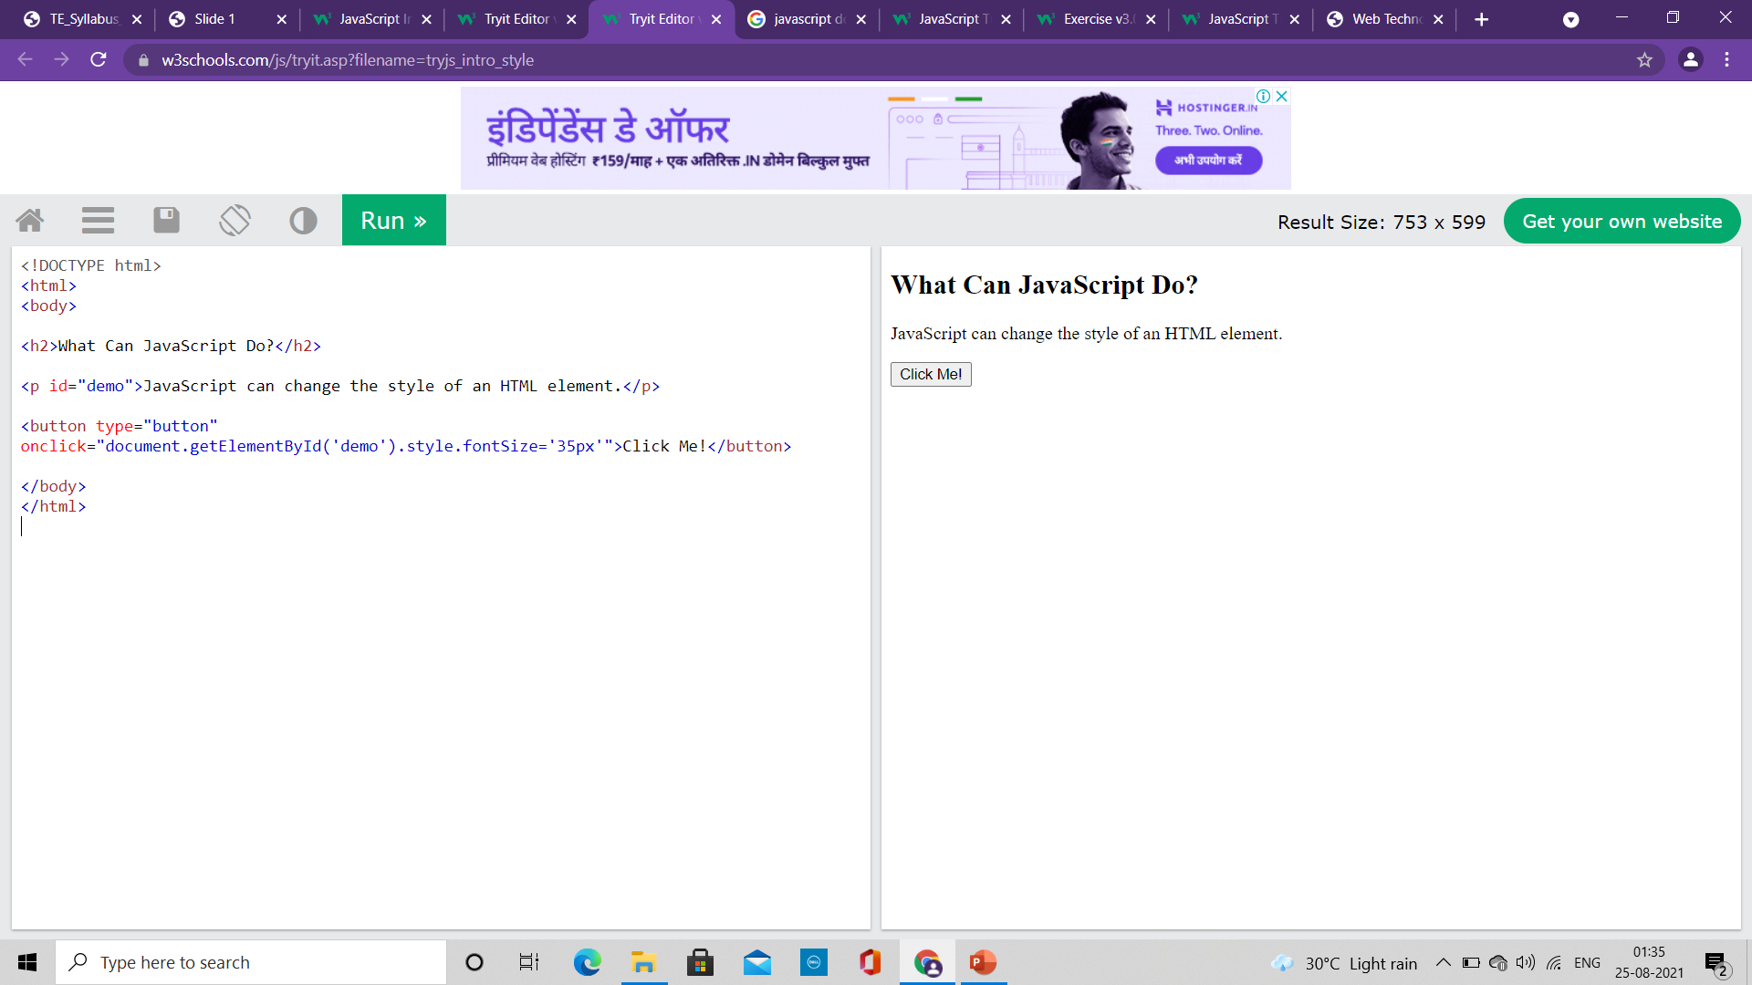
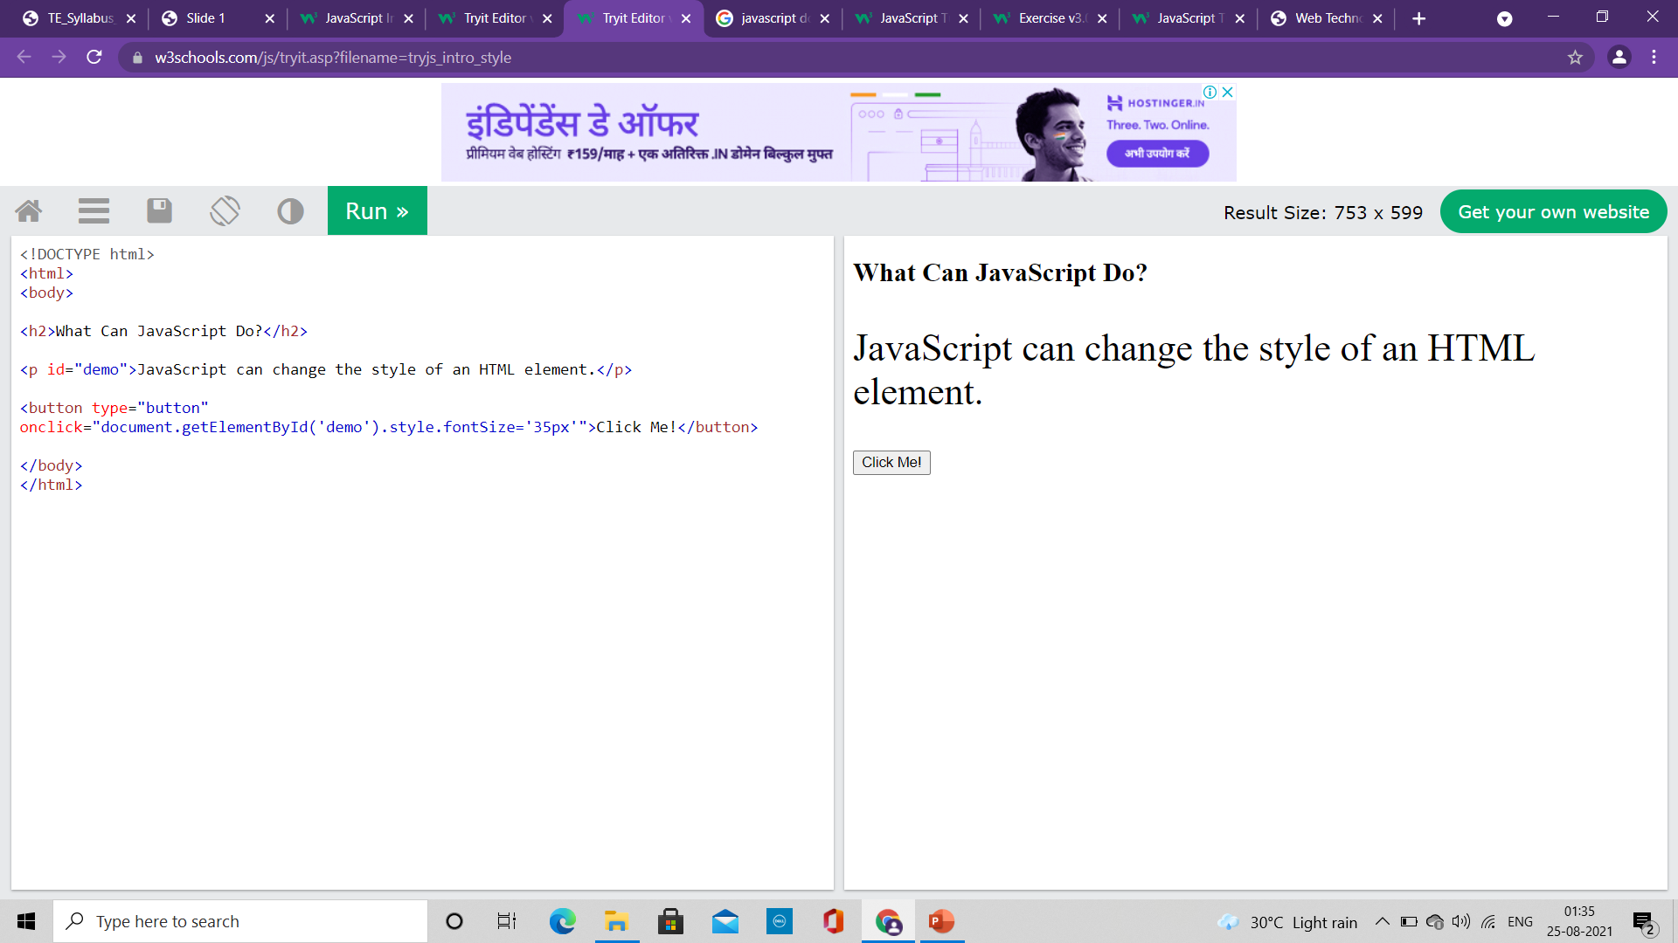
What JavaScript can do?
Change HTML Style (CSS)
<!DOCTYPE html>
<html>
<body>
<h2>What Can JavaScript Do?</h2>
<p id="demo">JavaScript can change the style of an HTML element.</p>
<button type="button" onclick="document.getElementById('demo').style.fontSize='35px'">Click Me!</button>
</body>
</html>

Slide 21
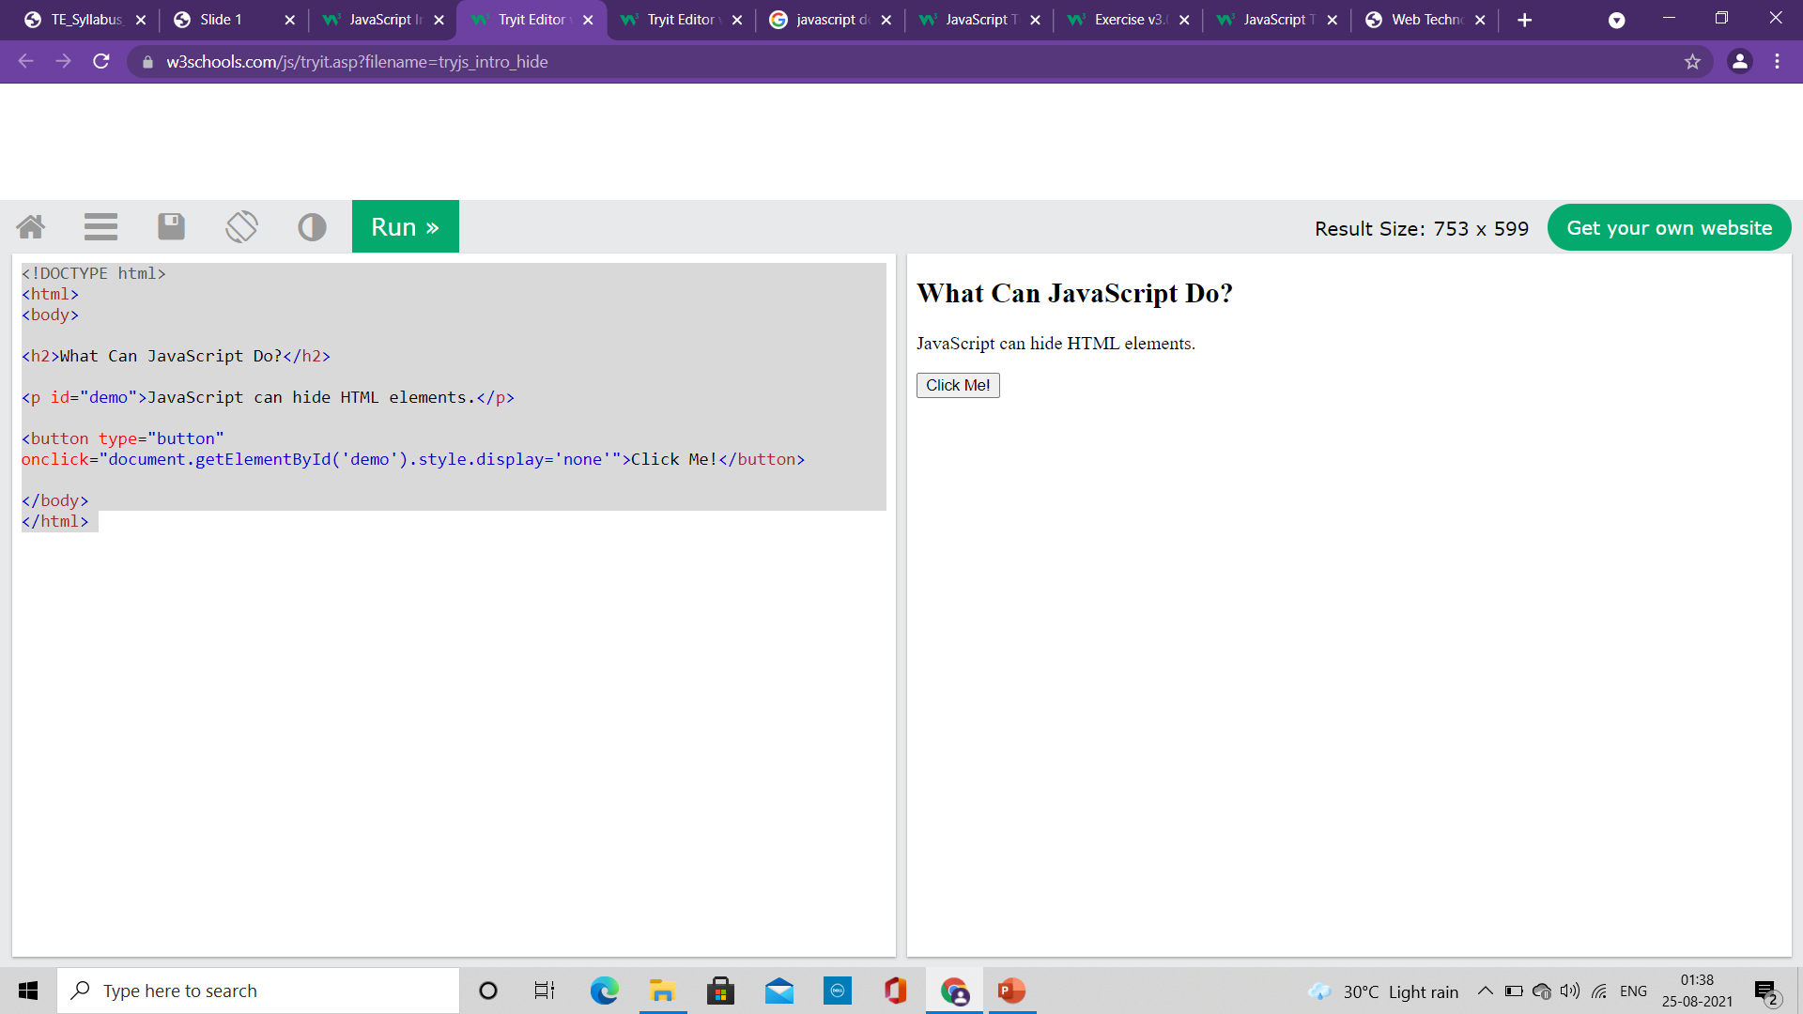

What JavaScript can do?
Hide HTML Elements
<!DOCTYPE html>
<html>
<body>
<h2>What Can JavaScript Do?</h2>
<p id="demo">JavaScript can hide HTML elements.</p>
<button type="button" onclick="document.getElementById('demo').style.display='none'">Click Me!</button>
</body>
</html>

Slide 22
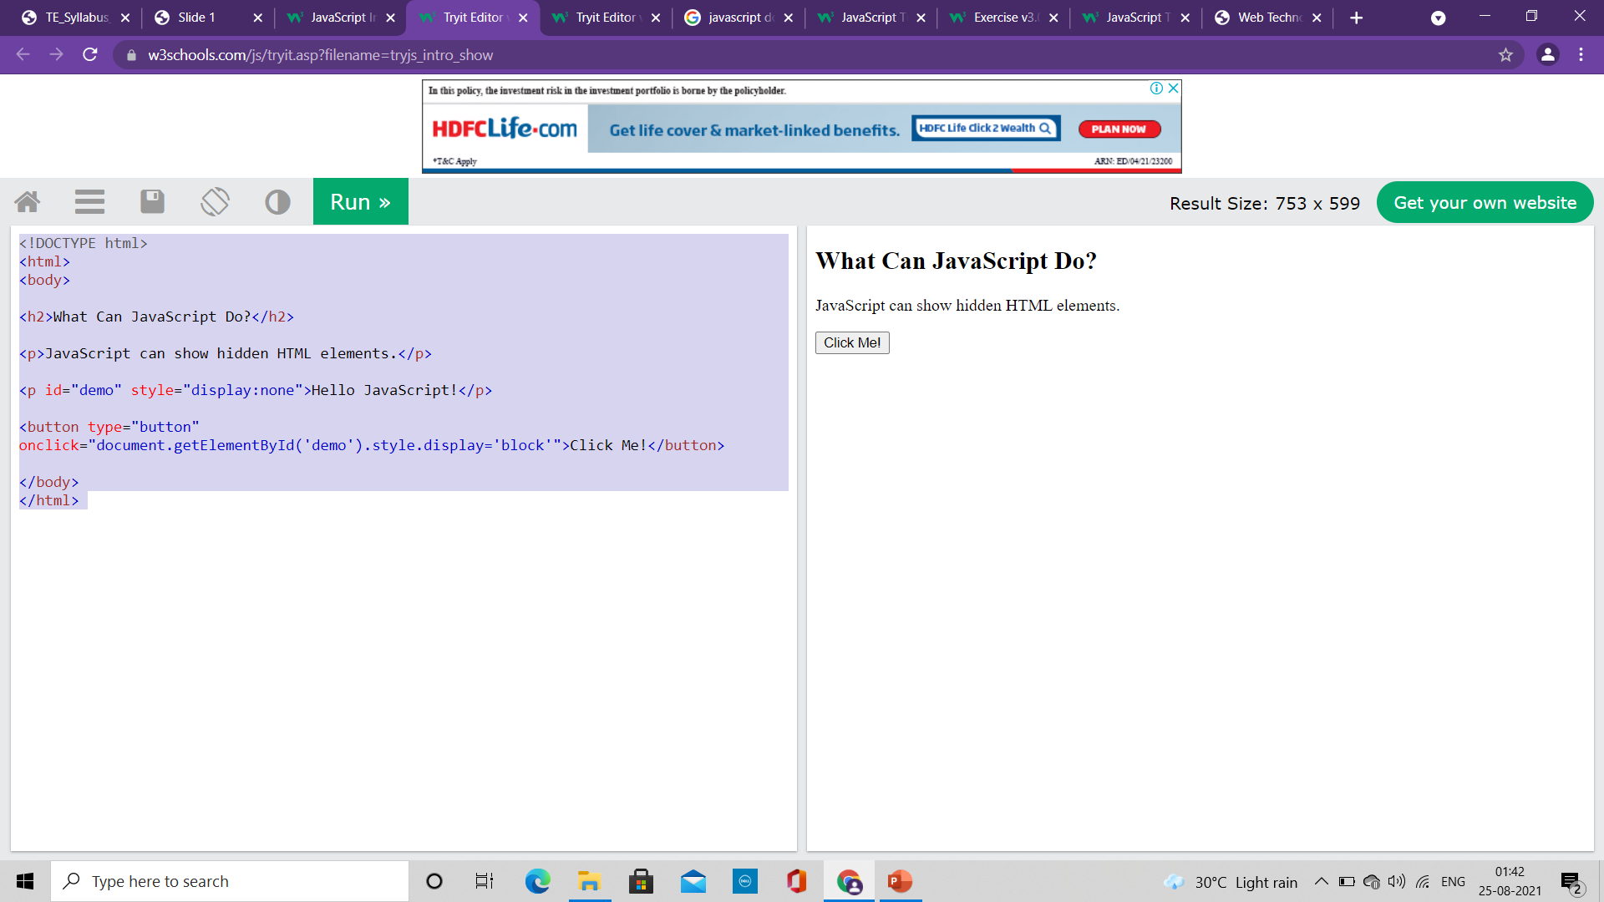
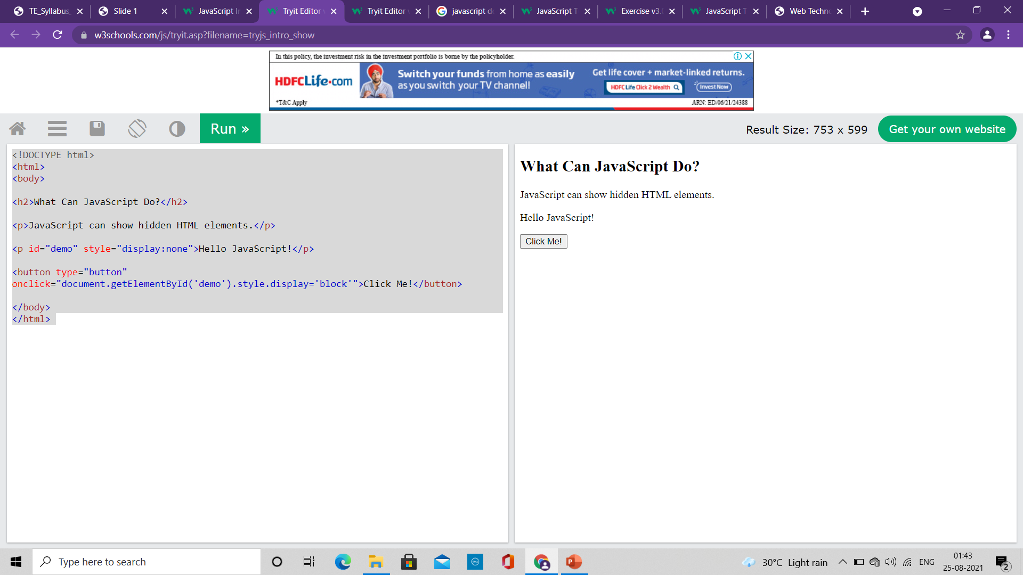
What JavaScript can do?
Show HTML Elements
<!DOCTYPE html>
<html>
<body>
<h2>What Can JavaScript Do?</h2>
<p>JavaScript can show hidden HTML elements.</p>
<p id="demo" style="display:none">Hello JavaScript!</p>
<button type="button" onclick="document.getElementById('demo').style.display='block'">Click Me!</button>
</body>
</html>

Slide 23
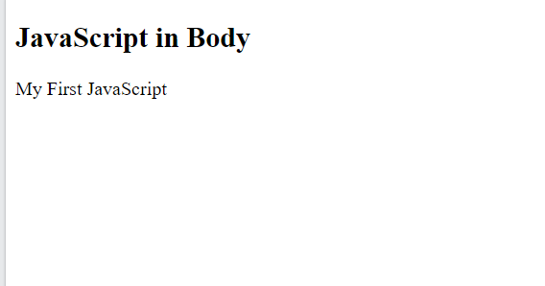
Where to write JavaScript code?
The <script> Tag
In HTML, JavaScript code is inserted between <script> and </script> tags.
We can place any number of scripts in an HTML document.
Scripts can be placed in the <body>, or in the <head> section of an HTML page, or in both.
<!DOCTYPE html>
<html>
<body>
<h2>JavaScript in Body</h2>
<p id="demo"></p>
<script>
document.getElementById("demo").innerHTML = "My First JavaScript";
</script>
</body>
</html>

Slide 24
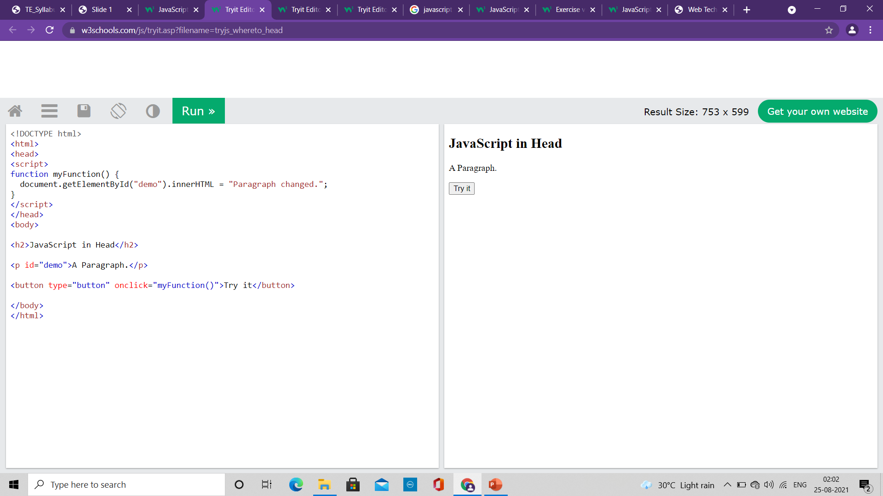

Where to write JavaScript code?
<!DOCTYPE html>
<html>
<head>
<script>
function myFunction() {
document.getElementById("demo").innerHTML = "Paragraph changed.";
}
</script>
</head>
<body>
<h2>JavaScript in Head</h2>
<p id="demo">A Paragraph.</p>
<button type="button" onclick="myFunction()">Try it</button>
</body>
</html>
A JavaScript function
It is a block of JavaScript code, that can be executed when "called" for.
Example: a function can be called when an event occurs, like when the user clicks a button.
Script is written in the head

Slide 25
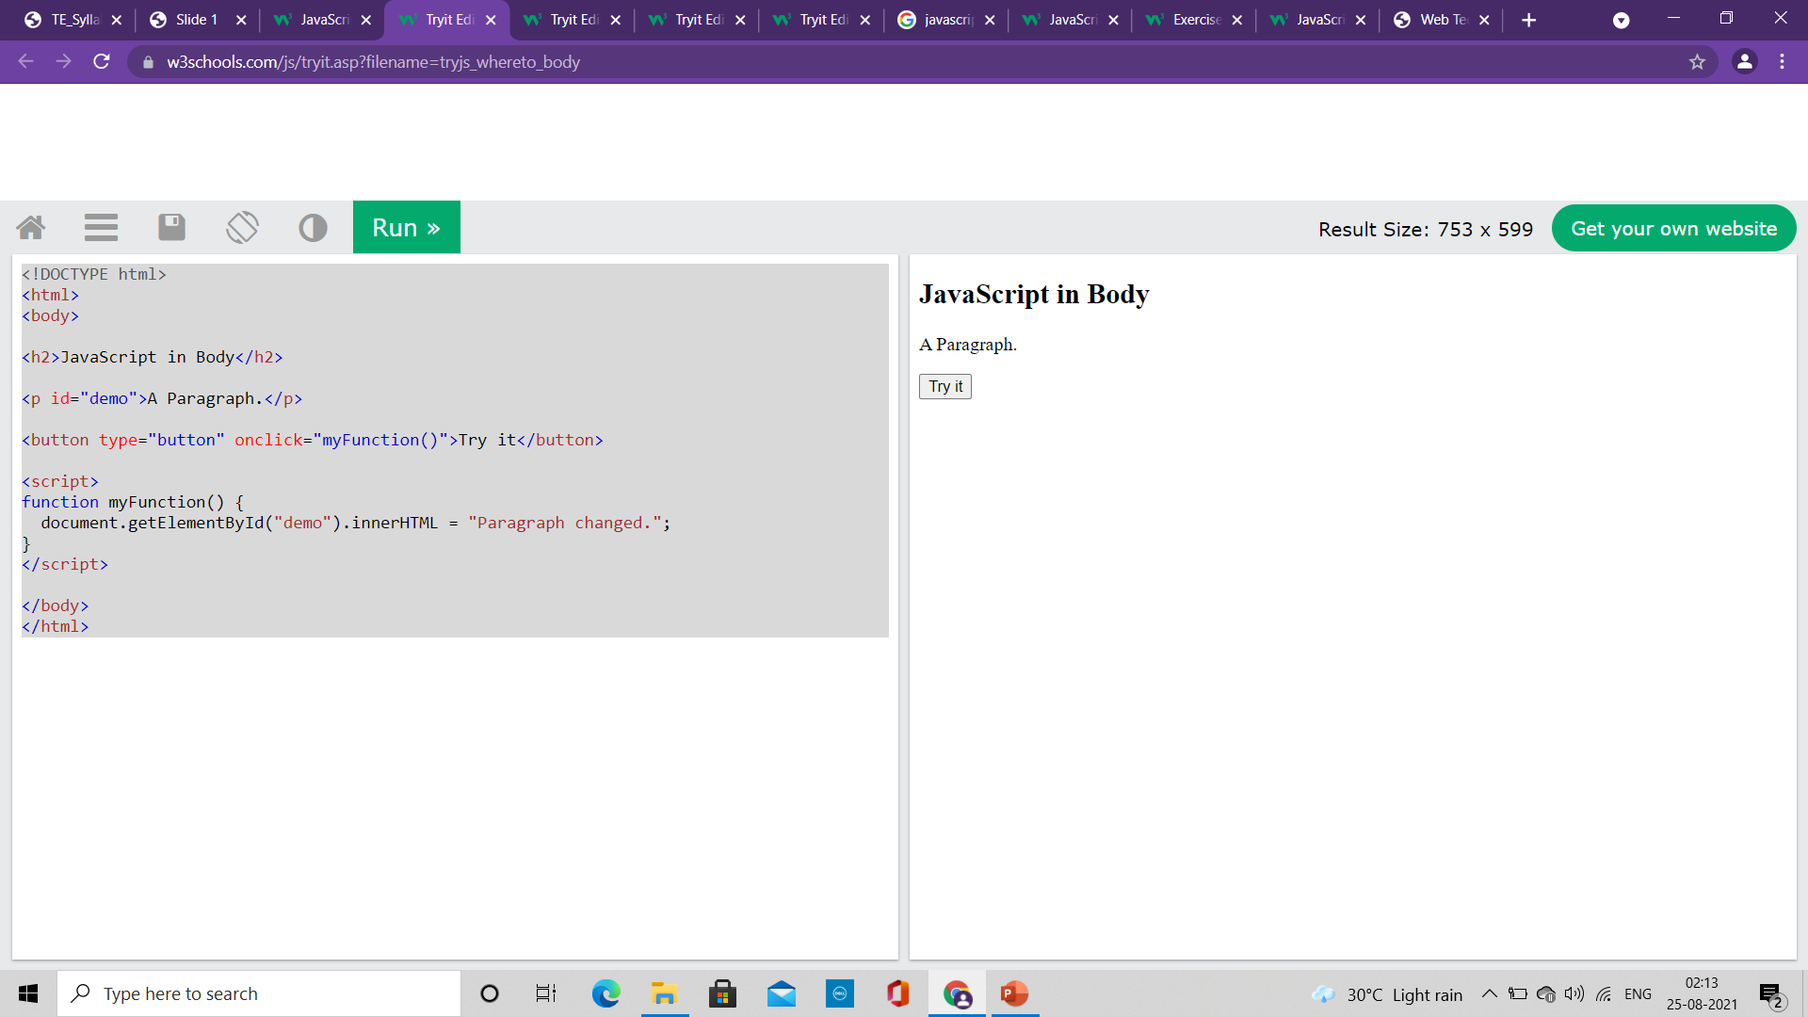

Where to write JavaScript code?
<!DOCTYPE html>
<html>
<body>
<h2>JavaScript in Body</h2>
<p id="demo">A Paragraph.</p>
<button type="button" onclick="myFunction()">Try it</button>
<script>
function myFunction() {
document.getElementById("demo").innerHTML = "Paragraph changed.";
}
</script>
</body>
</html>
A JavaScript function
It is a block of JavaScript code, that can be executed when "called" for.
Example: a function can be called when an event occurs, like when the user clicks a button.
Script is written in the body

Slide 26
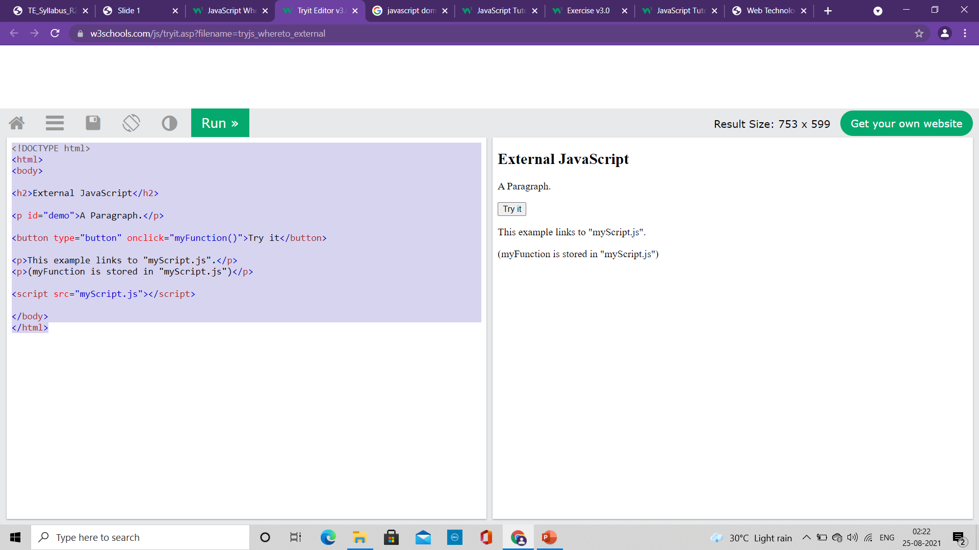
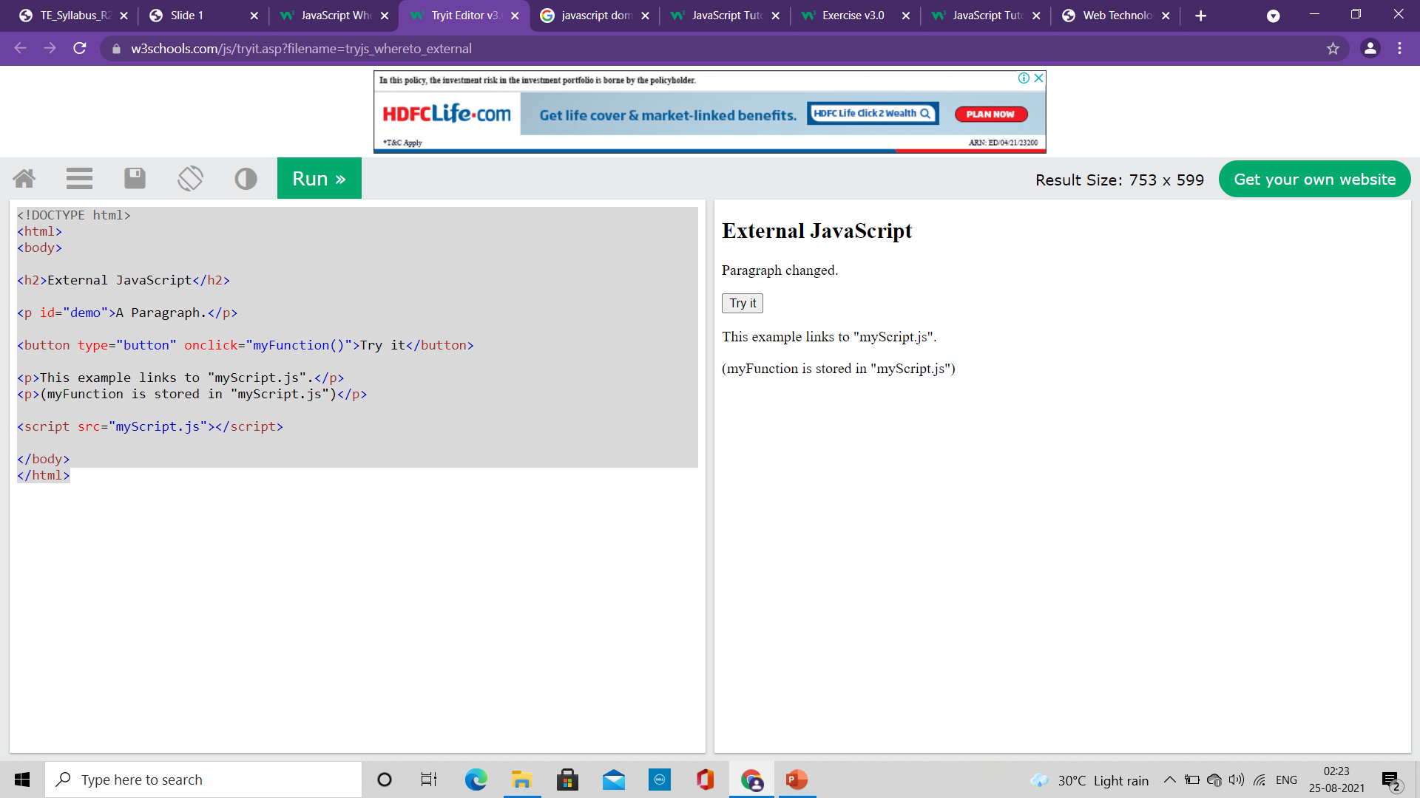
Where to write JavaScript code?
External JavaScript
Scripts can also be placed in external files
External scripts are practical when the same code is used in many different web pages.
JavaScript files have the file extension .js.
To use an external script, put the name of the script file in the src (source) attribute of a <script> tag
You can place an external script reference in <head> or <body> as you like.
The script will behave as if it was located exactly where the <script> tag is located.
External scripts cannot contain <script> tags.
<!DOCTYPE html>
<html>
<body>
<h2>External JavaScript</h2>
<p id="demo">A Paragraph.</p>
<button type="button" onclick="myFunction()">Try it</button>
<p>This example links to "myScript.js".</p>
<p>(myFunction is stored in "myScript.js")</p>
<script src="myScript.js"></script>
</body>
</html>
function myFunction() { document.getElementById("demo").innerHTML = "Paragraph changed."; }
myScript.js

Slide 27
Where to write JavaScript code?
External JavaScript
Placing scripts in external files has some advantages:
It separates HTML and code
It makes HTML and JavaScript easier to read and maintain
Cached JavaScript files can speed up page loads
To add several script files to one page - use several script tags:
<script src="myScript1.js"></script> <script src="myScript2.js"></script>

Slide 28
Where to write JavaScript code?
External References
An external script can be referenced in 3 different ways:
With a full URL (a full web address)
Example: <script src="https://www.w3schools.com/js/myScript.js"></script>
With a file path (like /js/)
Example: <script src="/js/myScript.js"></script>
Without any path
Example: <script src="myScript.js"></script>

Slide 29
JavaScript Output
JavaScript can "display" data in different ways:
Writing into an HTML element, using innerHTML.
Writing into the HTML output using document.write().
Writing into an alert box, using window.alert().
Writing into the browser console, using console.log().

Slide 30
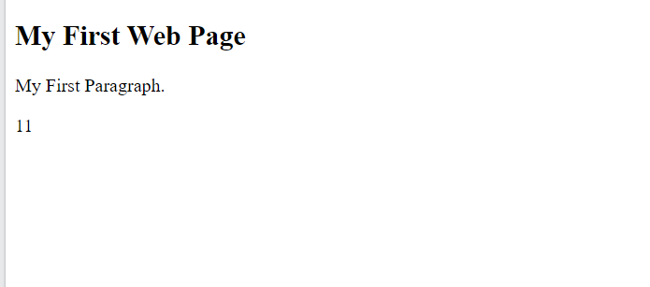
JavaScript Output
<!DOCTYPE html> <html> <body> <h1>My First Web Page</h1> <p>My First Paragraph</p> <p id="demo"></p> <script> document.getElementById("demo").innerHTML = 5 + 6; </script> </body> </html>
innerHTML
To access an HTML element, JavaScript can use the document.getElementById(id) method.
The id attribute defines the HTML element. The innerHTML property defines the HTML content:

Slide 31

JavaScript Output
<!DOCTYPE html> <html> <body> <h1>My First Web Page</h1> <p>My first paragraph.</p> <script> document.write(5 + 6); </script> </body> </html>
Document.write()
For testing purposes, it is convenient to use document.write()
Using document.write() after an HTML document is loaded, will delete all existing HTML

Slide 32
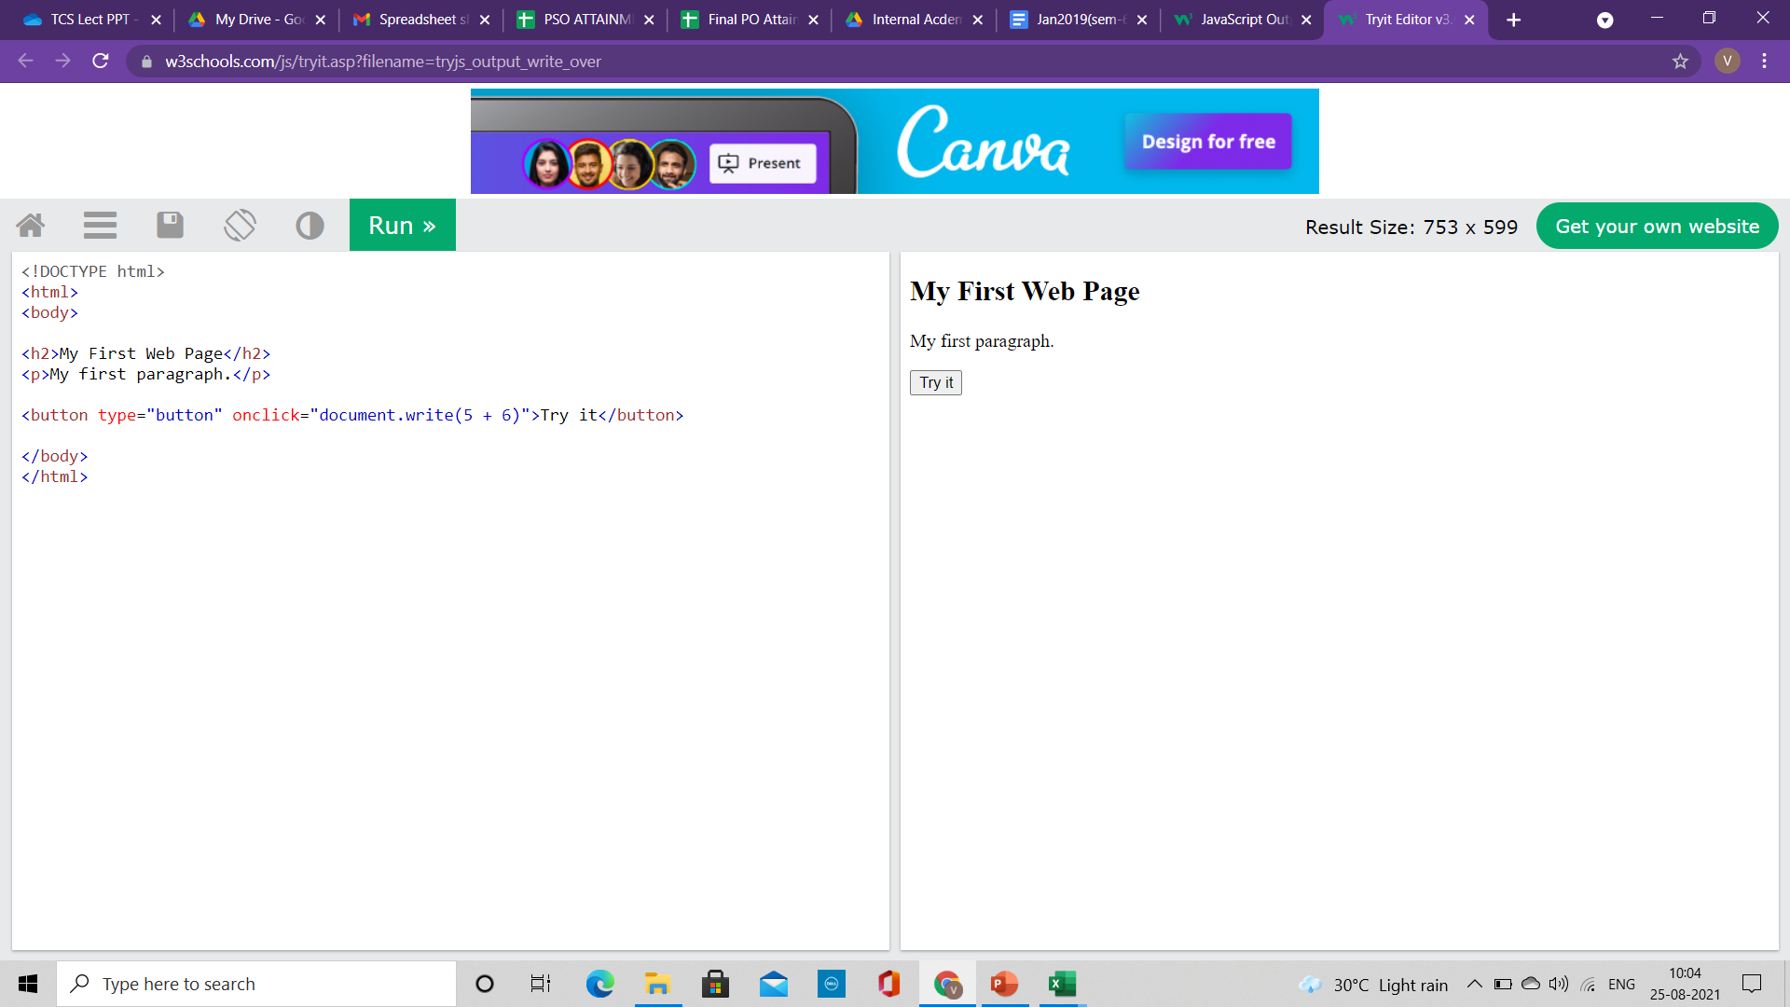
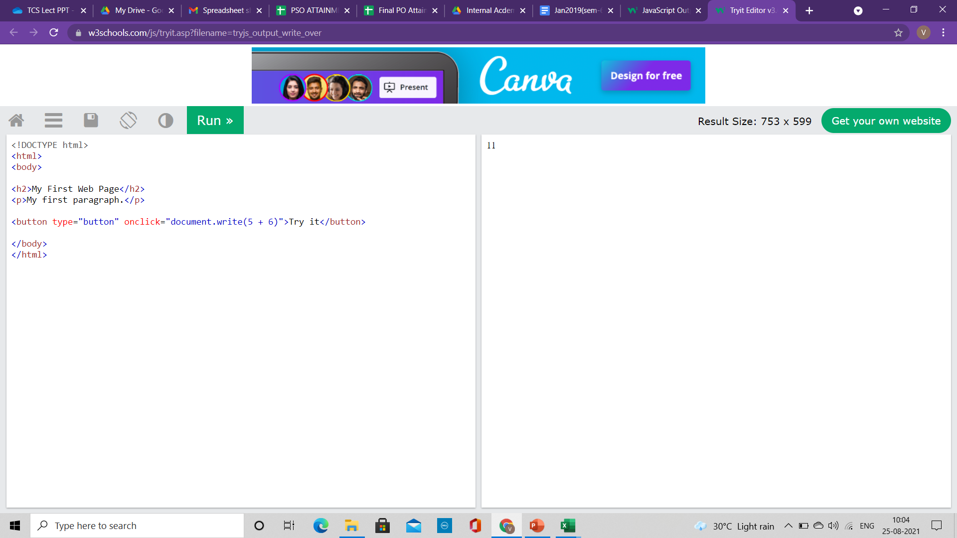
JavaScript Output
<!DOCTYPE html> <html> <body> <h1>My First Web Page</h1> <p>My first paragraph.</p> <button type="button" onclick="document.write(5 + 6)">Try it</button> </body> </html>
Document.write()
For testing purposes, it is convenient to use document.write()
Using document.write() after an HTML document is loaded, will delete all existing HTML

Slide 33
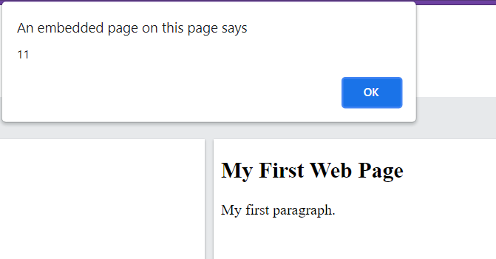
JavaScript Output
<!DOCTYPE html> <html> <body> <h1>My First Web Page</h1> <p>My first paragraph.</p> <script> window.alert(5 + 6); </script> </body> </html>
windows.alert()
We can use an alert box to display data
We can skip the window keyword.
In JavaScript, the window object is the global scope object,
It means that variables, properties, and methods by default belong to the window object.
This also means that specifying the window keyword is optional

Slide 34
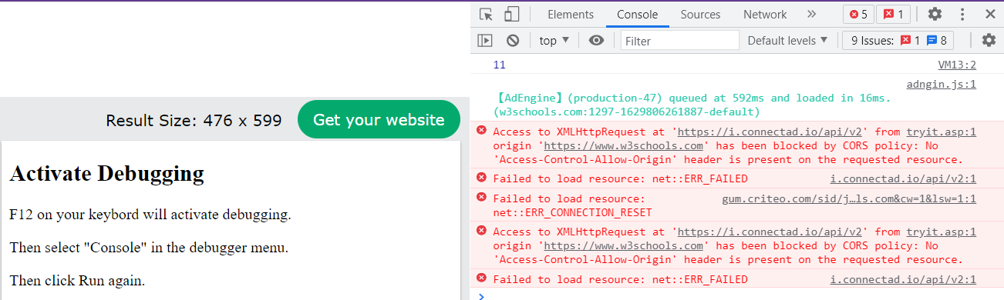
JavaScript Output
<!DOCTYPE html>
<html>
<body>
<h2>Activate Debugging</h2>
<p>F12 on your keyboard will activate debugging.</p>
<p>Then select "Console" in the debugger menu.</p>
<p>Then click Run again.</p>
<script>
console.log(5 + 6);
</script>
</body>
</html>
Console.log()
For debugging purposes, we can call the console.log() method in the browser to display data

Slide 35
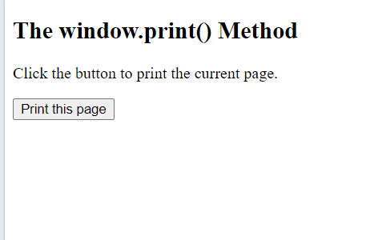
JavaScript Output
<!DOCTYPE html>
<html>
<body>
<h2>The window.print() Method</h2>
<p>Click the button to print the current page.</p>
<button onclick="window.print()">Print this page</button>
</body>
</html>
windows.print()
JavaScript does not have any print object or print methods.
You cannot access output devices from JavaScript.
The only exception is that you can call the window.print() method in the browser to print the content of the current window.

Slide 36
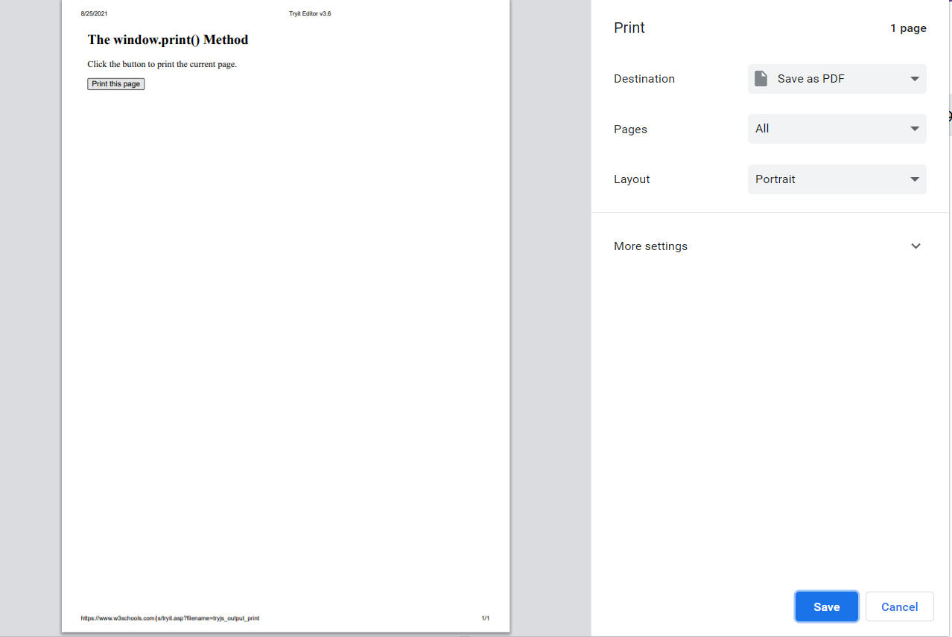
JavaScript Output
<!DOCTYPE html>
<html>
<body>
<h2>The window.print() Method</h2>
<p>Click the button to print the current page.</p>
<button onclick="window.print()">Print this page</button>
</body>
</html>
windows.print()
JavaScript does not have any print object or print methods.
You cannot access output devices from JavaScript.
The only exception is that you can call the window.print() method in the browser to print the content of the current window.

